Slide 1

Transport Layer Protocols TCP/IP Protocol Suit
Key function of the Transport Layer Protocols
Introduction to Transport Protocols Similar to TCP
TCP/IP Protocol Suit (part-1)
The Service TCP Provides to Applications
TCP Header Structure
TCP Congestion Control Algorithms
The Internet Protocol (IP) (part-2)
IP Addresses
IP Header Structure

Slide 2
TCP/IP Protocol Suit
The TCP/IP suite includes the following protocols:
TCP – Transmission Control Protocol
IPv4 / IPv6 – Internet Protocol
Notes:
TCP works on transport layer of OSI model. While IP works on network layer of OSI model.
IPv4- 32 bit address space
IPv6- 128 bit address space
Security and Size of addresses is the main difference b/w IPv4 & IPv6.
Packet address plus actual data -> Datagram
IP protocol maintain address while TCP make sure the communication woks fine.

Slide 3
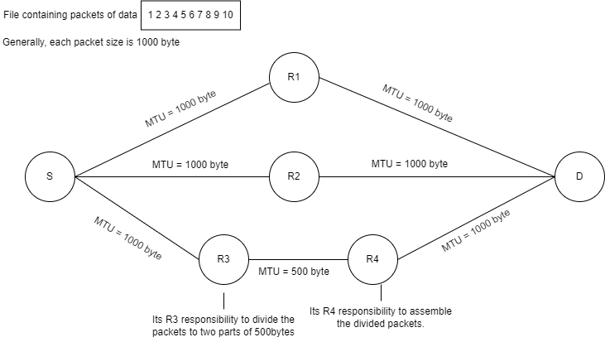
IP Protocol Suit
IP maintain address
When an IP datagram is longer than the MTU of the network, it is broken into smaller packets and reassembled at its final destination.
By: Ali Ahmed

Slide 4
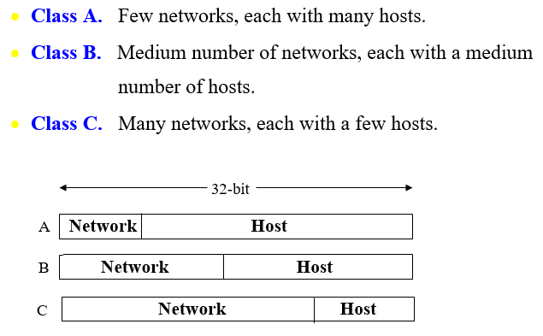
The Internet Protocol (IP)
(126 networks with 16 millions hosts each)
(16382 networks with up to 64K hosts)
(2 millions networks with 254 hosts each)
Notes:
A class: 2⁸ network & 224 -2
D class for Broadcast purpose
E class for Experimental purpose

Slide 5
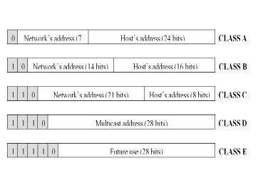
The Internet Protocol (IP)
(2⁷ networks with 2²⁴ hosts each)
(2¹⁴ networks with up to 2¹⁶ hosts)
(2²¹ networks with 2⁸ hosts each)
By: Ali Ahmed
Notes:
Class A – first bit is fixed
Class B – first two bits are fixed
Class C – first three bits are fixed

Slide 6
The Internet Protocol (IP)
Network address, which are 32-bit numbers, are usually written in dotted decimal notation
Each of the 4 bytes is written as from 0 to 255
The lowest IP address is 0.0.0.0 and highest is 255.255.255.255
For example, consider the IP address 124.29.88.7

Slide 7
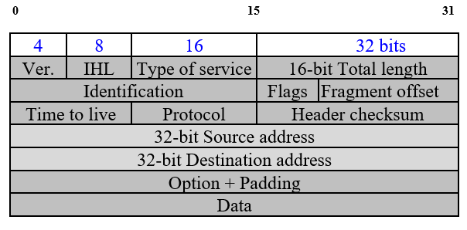
IP Header Structure
Notes:
Minimum IP Header Size = 20 bytes
4-bit Ver.: IP-Version
4-bit IHL: Internet Header Length
8-bit Type of service:
8-bit type of service indicates quality of service.
Services precedence.
Services priority. (e.g.: 1000 ka package(fast network). 100 ka package(slow network), monthly, weekly, social packages handled by priority.)
16-bit Total length: total length of datagram packet.
16-bit Identification: Range of sequence numbers of fragmented packets.
3-bit Flags:
If the flag is on, it means it is a fragmented packet.
If the flag is off, it means packet is not fragmented.
13-bit Fragment offset: Indicates where this fragment belong in datagram.
8-bit Time to live: If there is no destination address or wrong address of some packet. After its counter end. It’s discorded.
8-bit Protocol: Show that the packet belongs to which protocol, whether it is a TCP protocol packet or an IP protocol packet.
16-bit: Header checksum: error checking and detection of header.

Slide 8
Thank You
Q & A

